Slide 1
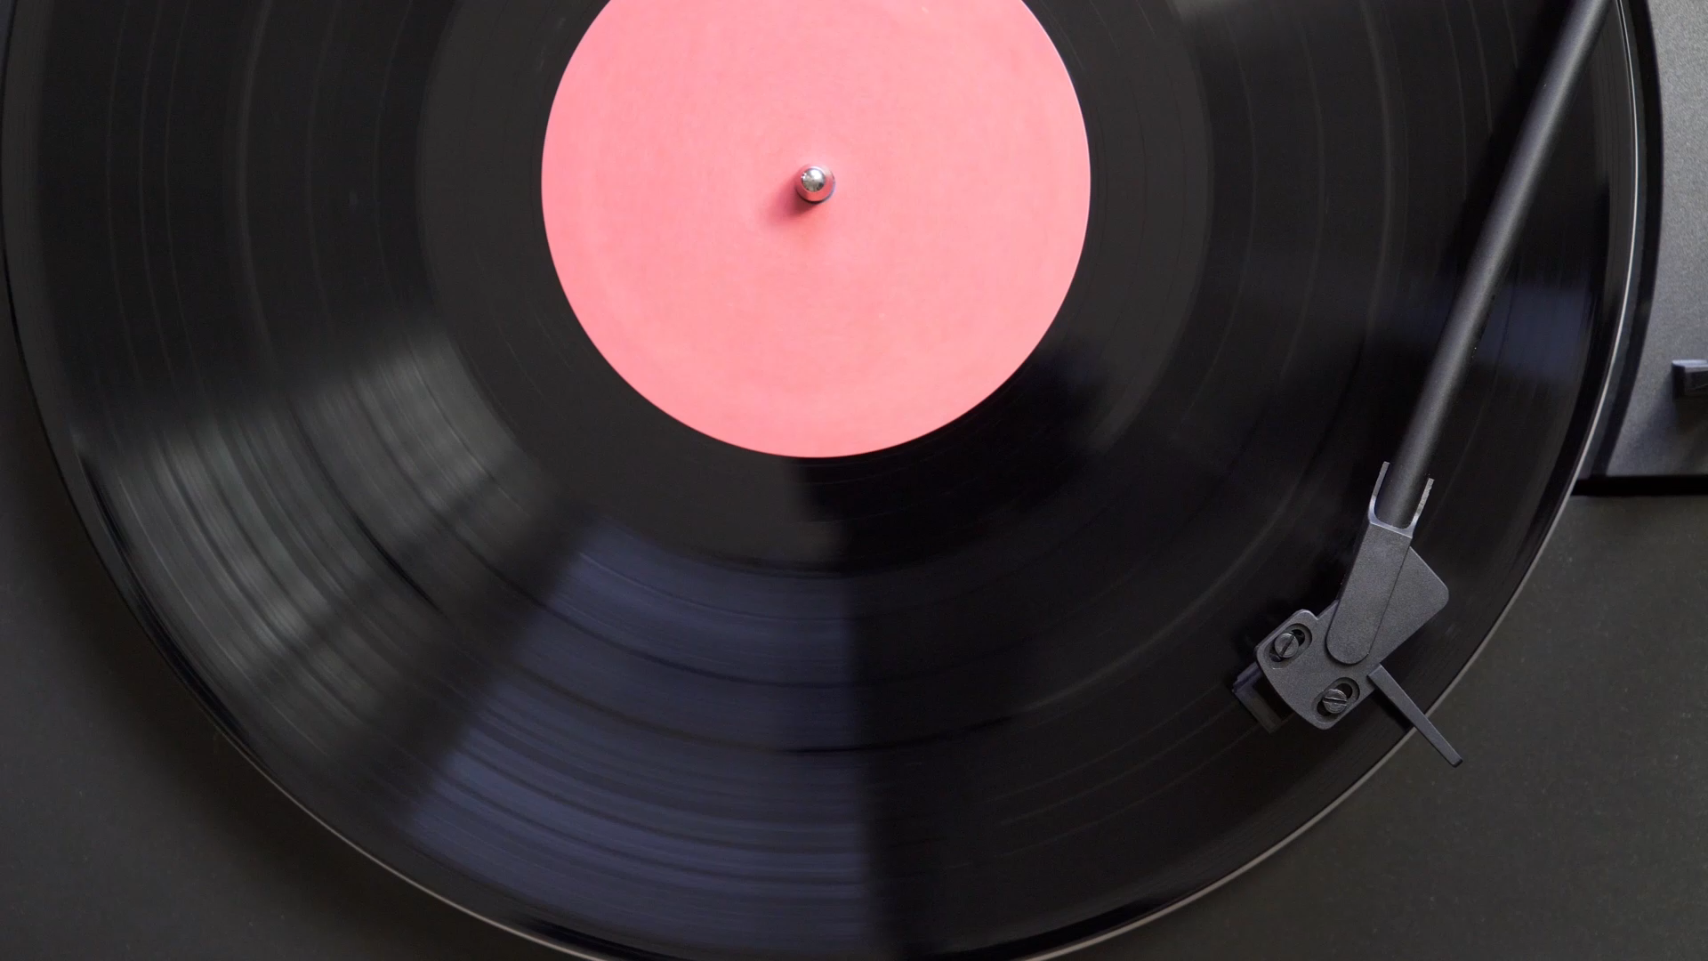
Landmark-based Audio Fingerprinting Using “audfprint”
Λέανδρος Αθερίνης-Σπαρτιώτης mtn2301
Ορεστης Βαγγέλης mtn2306

Slide 2





The GOAL
Create a system that identifies songs in a youtube video or a recording

Slide 3
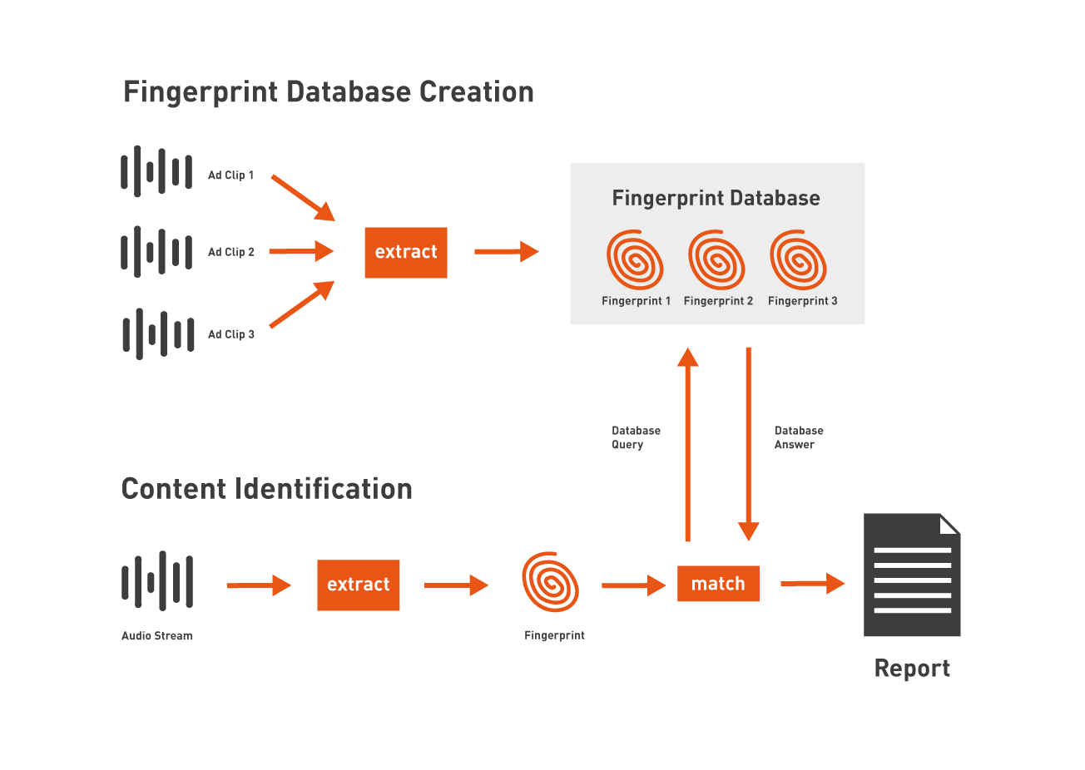
Audio Fingerprinting

Slide 4


Off-the-shelf Solutions
Dejavu
ShazamIO
PyAudioAnalysis Features linear distance threshold calculation
audfprint

Slide 5
audfprint
The best solution based on accuracy and inference time
Landmark-based fingerprinting

Slide 6
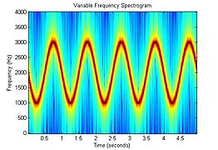
Steps
Audio Conversion – mono and resampling at a consistent sampling rate
Transform to spectrogram – STFT t(s) to f(Hz)
STFT breaks the audio signal into overlapping short segments (frames) and computes the Fourier Transform for each frame.
Create Spectrogram
A spectrogram is a visual representation of the spectrum of frequencies in a signal as it varies with time.
Horizontal axis: Time
Vertical axis: Frequency
Color intensity: Amplitude (or energy) of each frequency component

Slide 7
Identify Significant Peaks (Landmarks)
Peaks in the spectrogram, where the energy is concentrated, are identified.
These peaks are selected based on their local prominence compared to the surrounding areas.
Create time-frequency pairs
The identified peaks are paired to form time-frequency pairs.
Each pair is encoded into a compact 20-bit hash that captures the frequency of the first peak, the frequency difference to the second peak, and the time difference between the peaks.

Slide 8
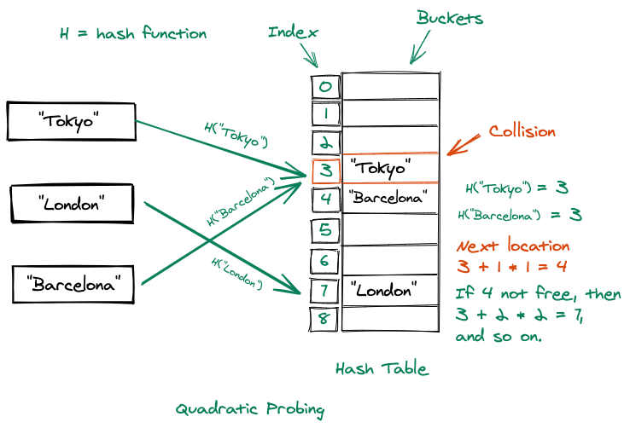
Store Fingerprints
The fingerprints are stored in a hash table.
Each hash is associated with the corresponding audio file and its time offset.
Query Process
The same fingerprinting process is applied to the query audio.
The resulting hashes are matched against those in the database.
Matches are aligned based on their time offsets, and the number of common hashes is counted.
Rank Matches
Matches are ranked by the number of aligned hashes.
This ensures robust and accurate identification of audio clips, even under challenging conditions.

Slide 9
Implementation
Youtube video
Manual Recording

Slide 10
Test Cases
We will rock you – A Knight’s Tale: https://www.youtube.com/watch?v=rr9roMoMT1Y
Nessun Dorma – Mission Impossible 5:
https://www.youtube.com/watch?v=ynzg9PmORN0
vs https://www.youtube.com/watch?v=cWc7vYjgnTs
Killing Strangers – Marilyn Manson high peaks -> high accuracy prima mostly

Slide 11
Results
Accuracy is high when only the song is contained in the signal.
Seems unable to identify covers.
Is quite accurate when other sounds are contained in the signal as long as they don’t mask the peaks. E.g., Nessun Dorma mi vs Tunradot & we will rock you - a knight’s tale

